Slide 1
Data Structures II
SPACE
EFFICIENT
DOCUMENT
FINGERPRINTING
Presented by:
Group 21
Simra Shamim
Arsal Jangda
Bilal Ahmed
Qazi Mustafa

Slide 2
PROJECT OVERVIEW
Problem Statement: Detecting plagiarism and content similarity is essential in academia and industry, where manual verification is infeasible for large datasets. This project provides an efficient, scalable, and user-friendly solution for identifying document similarity, leveraging advanced data structures and algorithms.
Real-World Relevance:
Academic plagiarism detection
Copyright enforcement
Large-scale content deduplication
Scientific research originality check

Slide 3
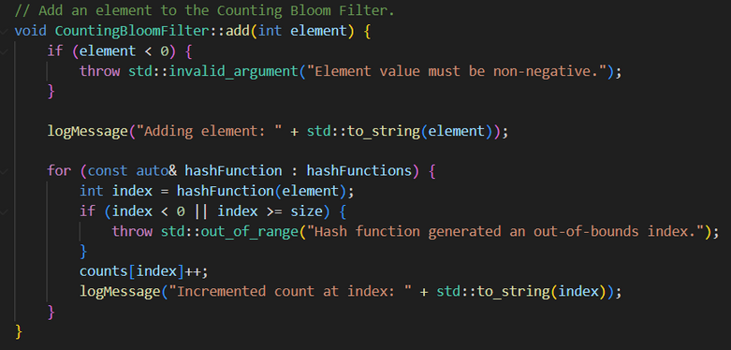
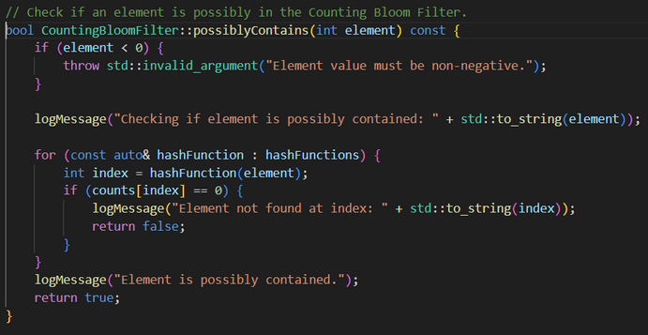
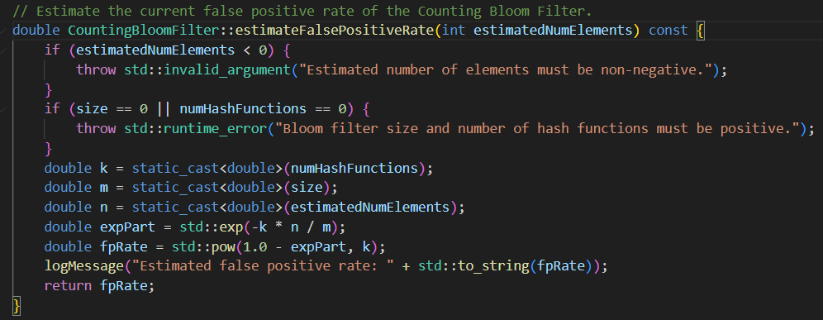
KEY DATA STRUCTURES USED
Counting Bloom Filter (CBF)
Purpose: A probabilistic data structure used for efficient membership testing with support for counting.
Why Chosen: It allows for approximate set membership queries with low memory usage, making it ideal for large-scale datasets.
How It Supports the Solution:
Stores document signatures efficiently.
Supports operations like adding elements, checking for possible containment, and removing elements.
Reduces false positives while maintaining scalability

Slide 4
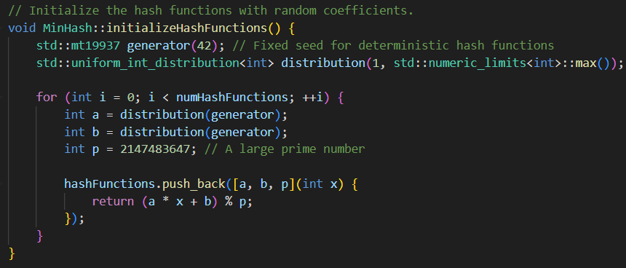

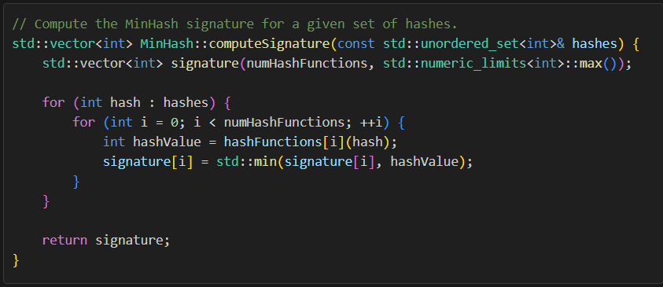


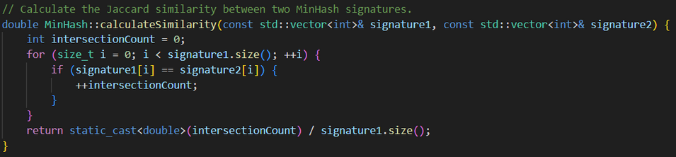
KEY DATA STRUCTURES USED
MinHash
Hash Function in MinHash:
This function ensures that each element in the set is mapped to a uniformly distributed hash value.
Jaccard Similarity:
The Jaccard Similarity between two sets A and B is approximated using MinHash signatures:
which in our context is:
Purpose: A technique for estimating the Jaccard similarity between sets.
Why Chosen: It provides a compact representation of sets, enabling efficient similarity comparisons.
How It Supports the Solution:
Generates fixed-length signatures for documents.
Facilitates fast similarity calculations between documents.

Slide 5
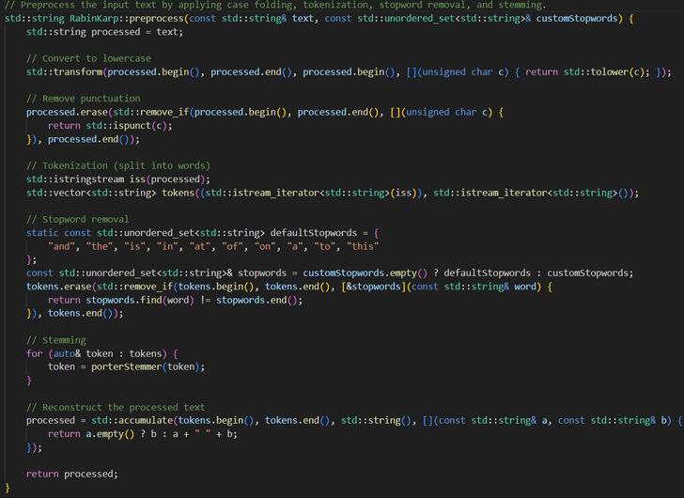


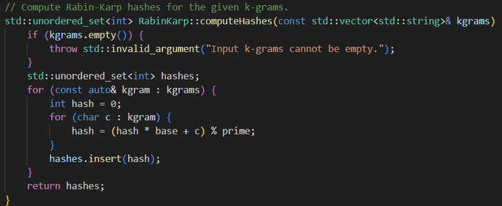
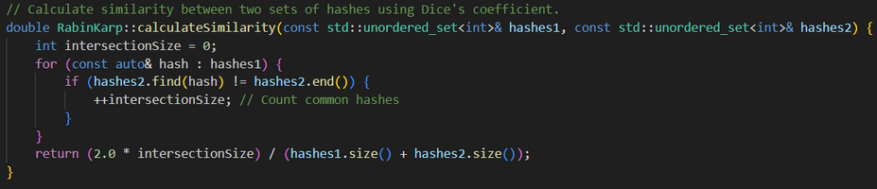
KEY DATA STRUCTURES USED
Rabin Karp
The hash function used in Rabin-Karp:
This function ensures that each k-gram is mapped to a unique hash value, enabling efficient substring matching.
Dice's Coefficient for Similarity:
This formula efficiently measures the similarity between two documents based on their hashed k-grams.
Purpose: A rolling hash algorithm used for substring matching and k-gram hashing.
Why Chosen: Efficiently computes hashes for k-grams, which are critical for document comparison.
How It Supports the Solution:
Preprocesses documents into k-grams and computes their hashes.
Calculates similarity scores using Dice's coefficient.
s = k-gram (length k substring)
base = A constant multiplier i.e. 11
prime = to reduce hash collisions (10000019)
A∩B: common hashes between the two sets.
|A|: size of ( A )
|B|: size of ( B )

Slide 6
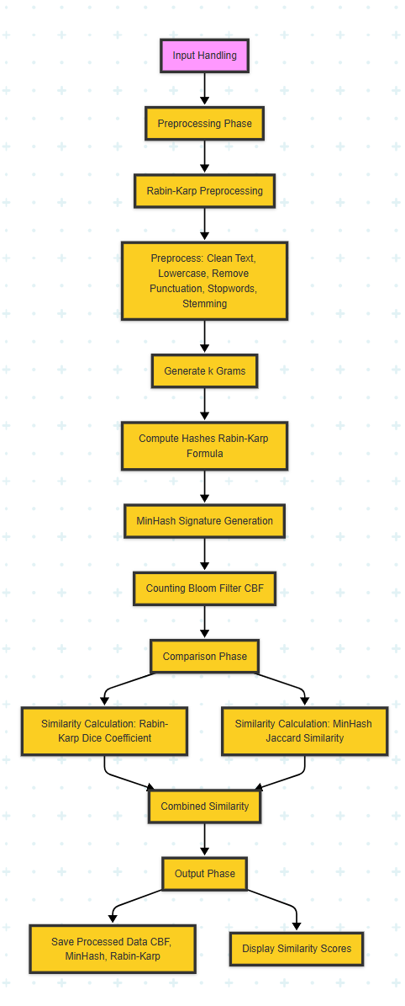
ARCHITECTURE & DESIGN FLOW
Input Handling
Main Entry Point: main.cpp
Command-line arguments:
--preprocess-dataset, --check, <doc1> <doc2>.
Preprocessing Phase
Rabin-Karp
Key Functions:
Preprocess: Clean text (lowercase, remove punctuation, stopwords, stemming).
Output: Cleaned string.
Generating k-Grams
Key Function:
generateKGrams: Splits text into k-grams.
Output: Vector of k-grams.
Rabin-Karp Hashes
File: RabinKarp.cpp
Key Function:
computeHashes: Computes hashes using formula.
Output: Set of unique hashes.
Counting Bloom Filter (CBF)
Key Functions:
add: Adds MinHash signature to CBF.
possiblyContains: Checks membership.
Output: Probabilistic data structure for efficient membership testing.
Comparison Phase
Similarity Calculation
Key Functions:
Rabin-Karp Similarity: Uses Dice’s Coefficient.
MinHash Similarity: Uses Jaccard Similarity.
Output: Two similarity scores.
Combined Similarity
Key Logic:
Combines scores
If similarity > 0.5, documents are considered "Similar."
Output Phase
Key Outputs:
In preprocessing mode: Saves processed data (CBF, MinHash, Rabin-Karp) to dataset_cbf.
In comparison mode: Displays similarity scores and verdict ("Similar" or "Not Similar").
Signature Generation Phase
MinHash Signature
Key Function:
computeSignature: Generates MinHash signature.
Output: Vector representing document.

Slide 7
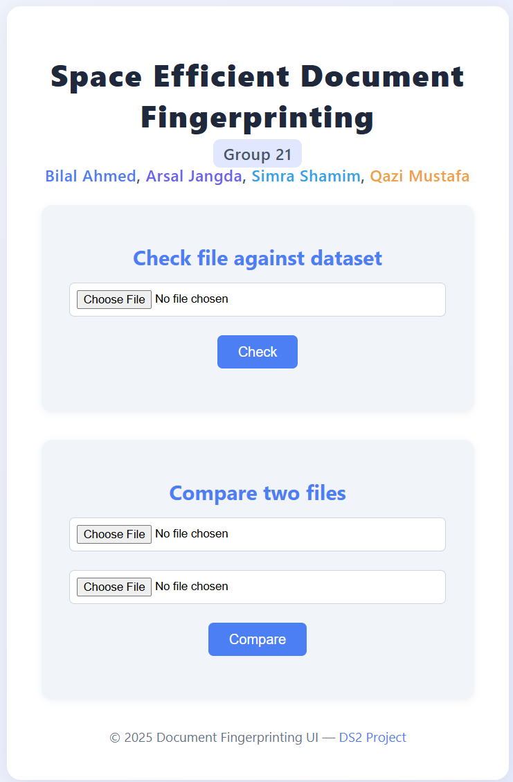
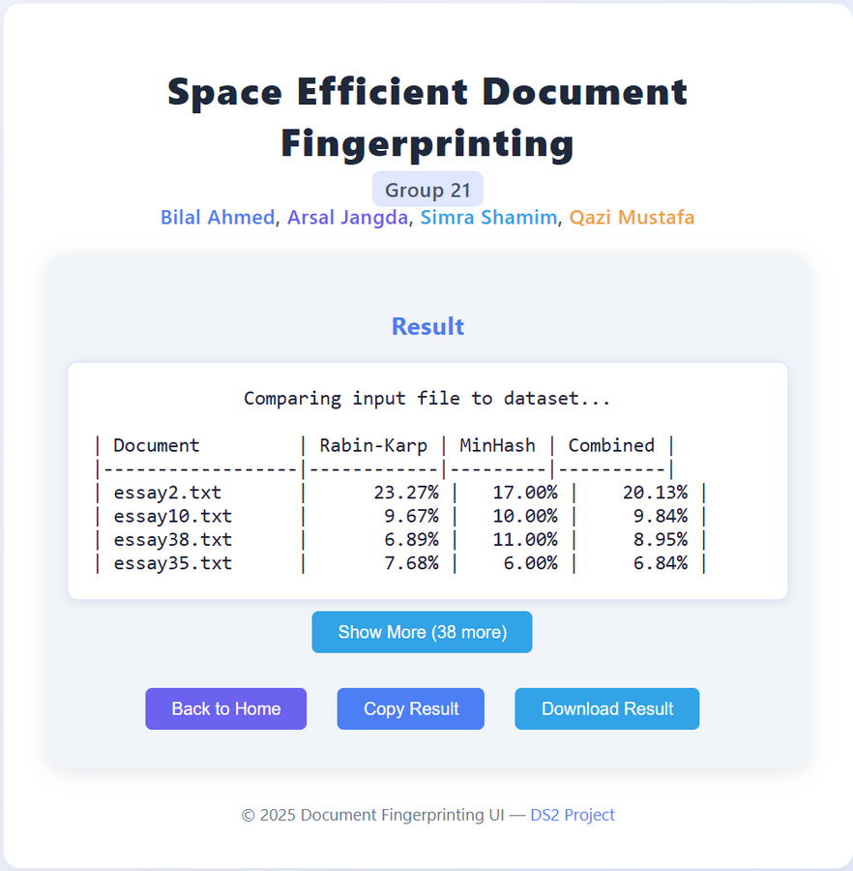
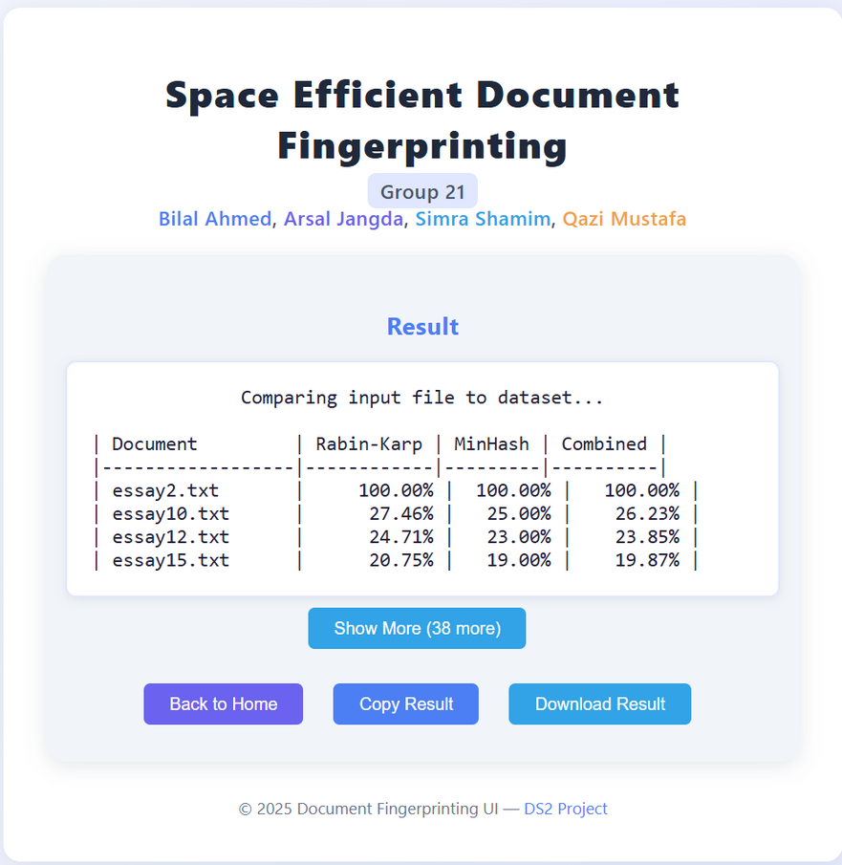
SNIPPETS

Slide 8
CHALLENGES AND LEARNINGS
Efficient Preprocessing:
Preprocessing large datasets
Solution: Optimized the stemming process.
Rabin-Karp Implementation:
Challenge: Hash collisions during k-gram hashing.
Solution: Linear probing, optimized parameters.
MinHash Signature Length:
Challenge: Optimal number of hash functions.
Solution: Different configurations.
Integration with Flask:
Challenge: Integrating the C++ backend with the Python Flask.
Solution: Subprocess calls and error handling.
Testing and Validation:
Challenge: Validating the correctness of each component.
Solution: Standalone test scripts and comparison with expected outputs.
Semantic Understanding:
Challenge:
Structural and lexical similarity,
Lacking semantic understanding.
Solution: Acknowledged this limitation.
False Positives in CBF:
Challenge: CBF produced false positives.
Solution: Adjusted the size and hash functions to reduce the false positive rate.

Slide 9
COMPARISON WITH MODERN NLP PRACTICES
Modern NLP Practices
Our Implementation
Key Differences
Vector Representations:
NLP uses embeddings like Word2Vec, GloVe, or BERT to represent documents as dense vectors.
These embeddings capture semantic relationships between words.
Neural Networks:
Models like Transformers (e.g., BERT, GPT) are used for deep semantic understanding.
They excel at tasks like context-aware similarity detection.
TF-IDF:
A traditional method that represents documents as sparse vectors based on term frequency and inverse document frequency.
Semantic Understanding:
NLP: Captures deeper meanings using embeddings and neural networks.
Ours: Focuses on syntactic and structural similarity, not semantic meaning.
Resource Usage:
NLP: Requires significant computational resources for training and inference.
Ours: Lightweight and scalable, optimized for efficiency.
Use Cases:
NLP: Ideal for tasks requiring semantic understanding (e.g., sentiment analysis, question answering).
Ours: Best suited for tasks like plagiarism detection and duplicate document identification.
Structural and Lexical Similarity:
Rabin-Karp Hashing: Focuses on structural similarity by generating k-gram hashes.
MinHash: Estimates Jaccard similarity for compact representation of sets.
Efficiency:
Uses Counting Bloom Filters for fast and space-efficient membership testing.
Lightweight Design:
Designed for scalability and efficiency, suitable for large datasets.

Slide 10

THANK YOU

